Slide 1
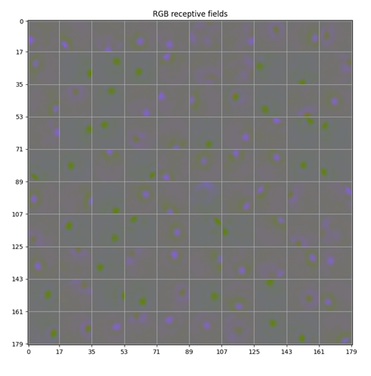
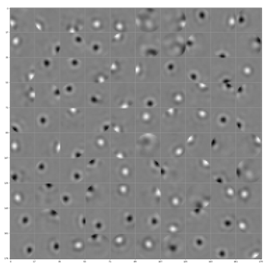
RFs with 100 RGCs

Slide 2
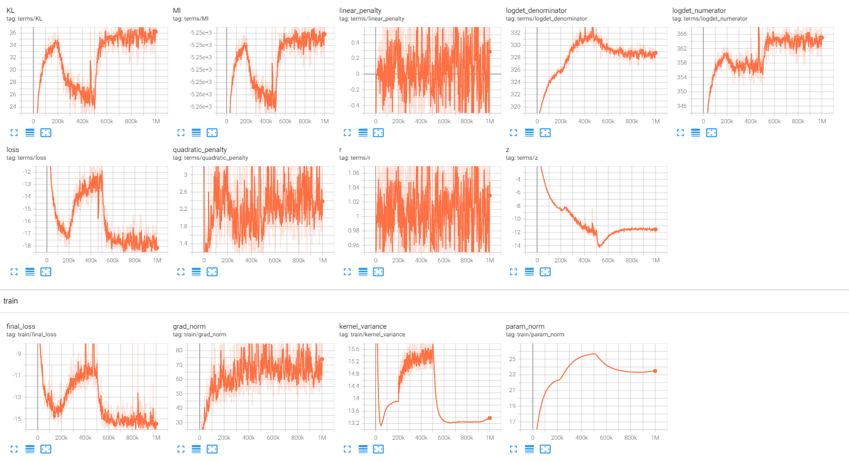

Slide 3
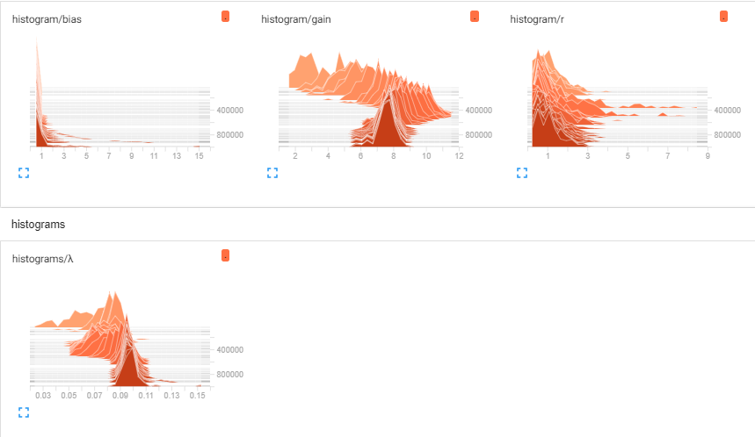
Tensorboard

Slide 4
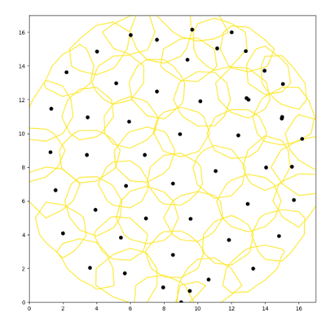
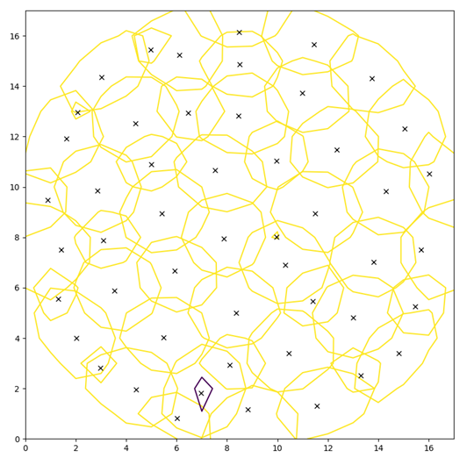
Contours with 100 RGCs
ON/blue center (50)
OFF/green center (50)

Slide 5
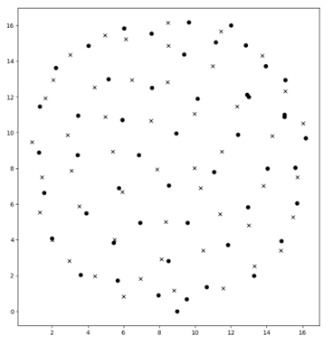
Anti-aligned mosaics? 100 RGCs

Slide 6
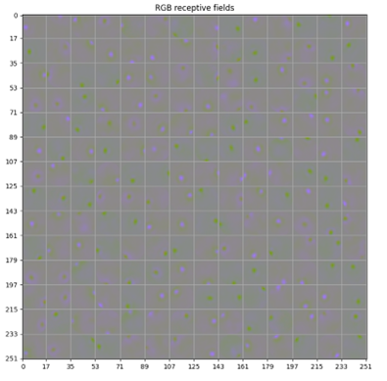
RFs with 200 RGCs

Slide 7
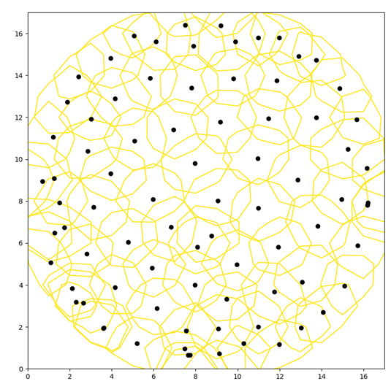
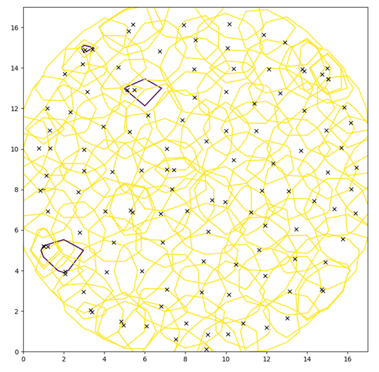
Contours with 200 RGCs
Blue/ON center (81)
Green/OFF center (119)

Slide 8
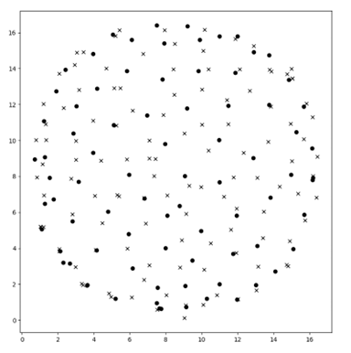
Mosaics with 200 RGCs

Slide 9
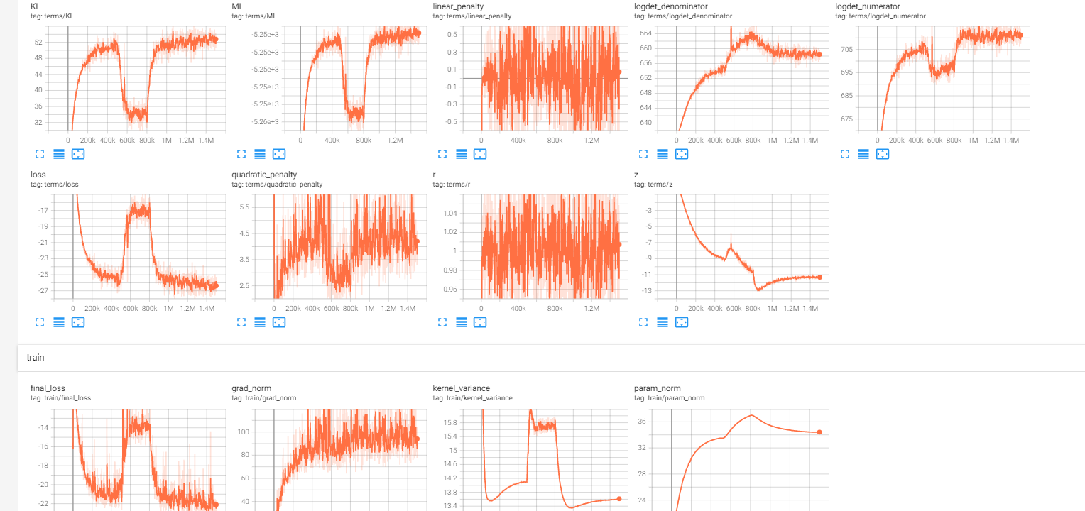
Tensorboard

Slide 10
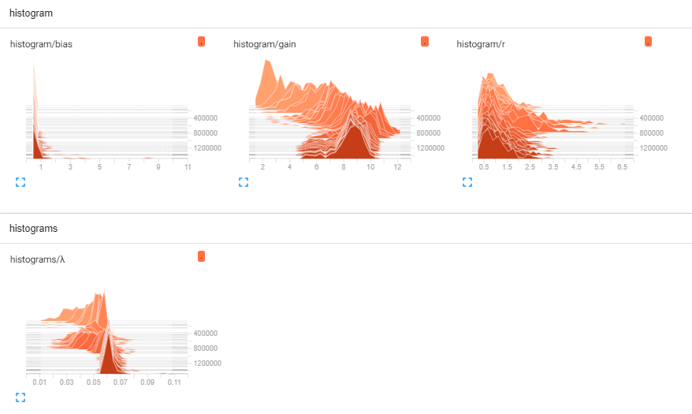
Tensorboard

Slide 11
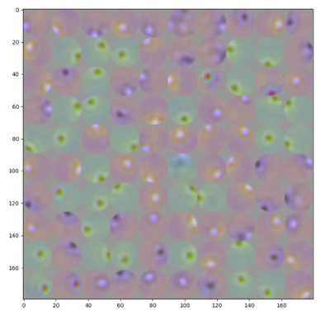
100 RFs in LMS space (Red = L, Green = M, Blue = S)

Slide 12
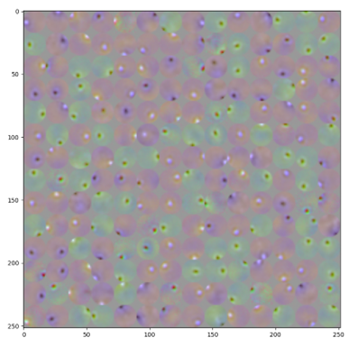
200 RFs in LMS space (Red = L, Green = M, Blue = S)

Slide 13
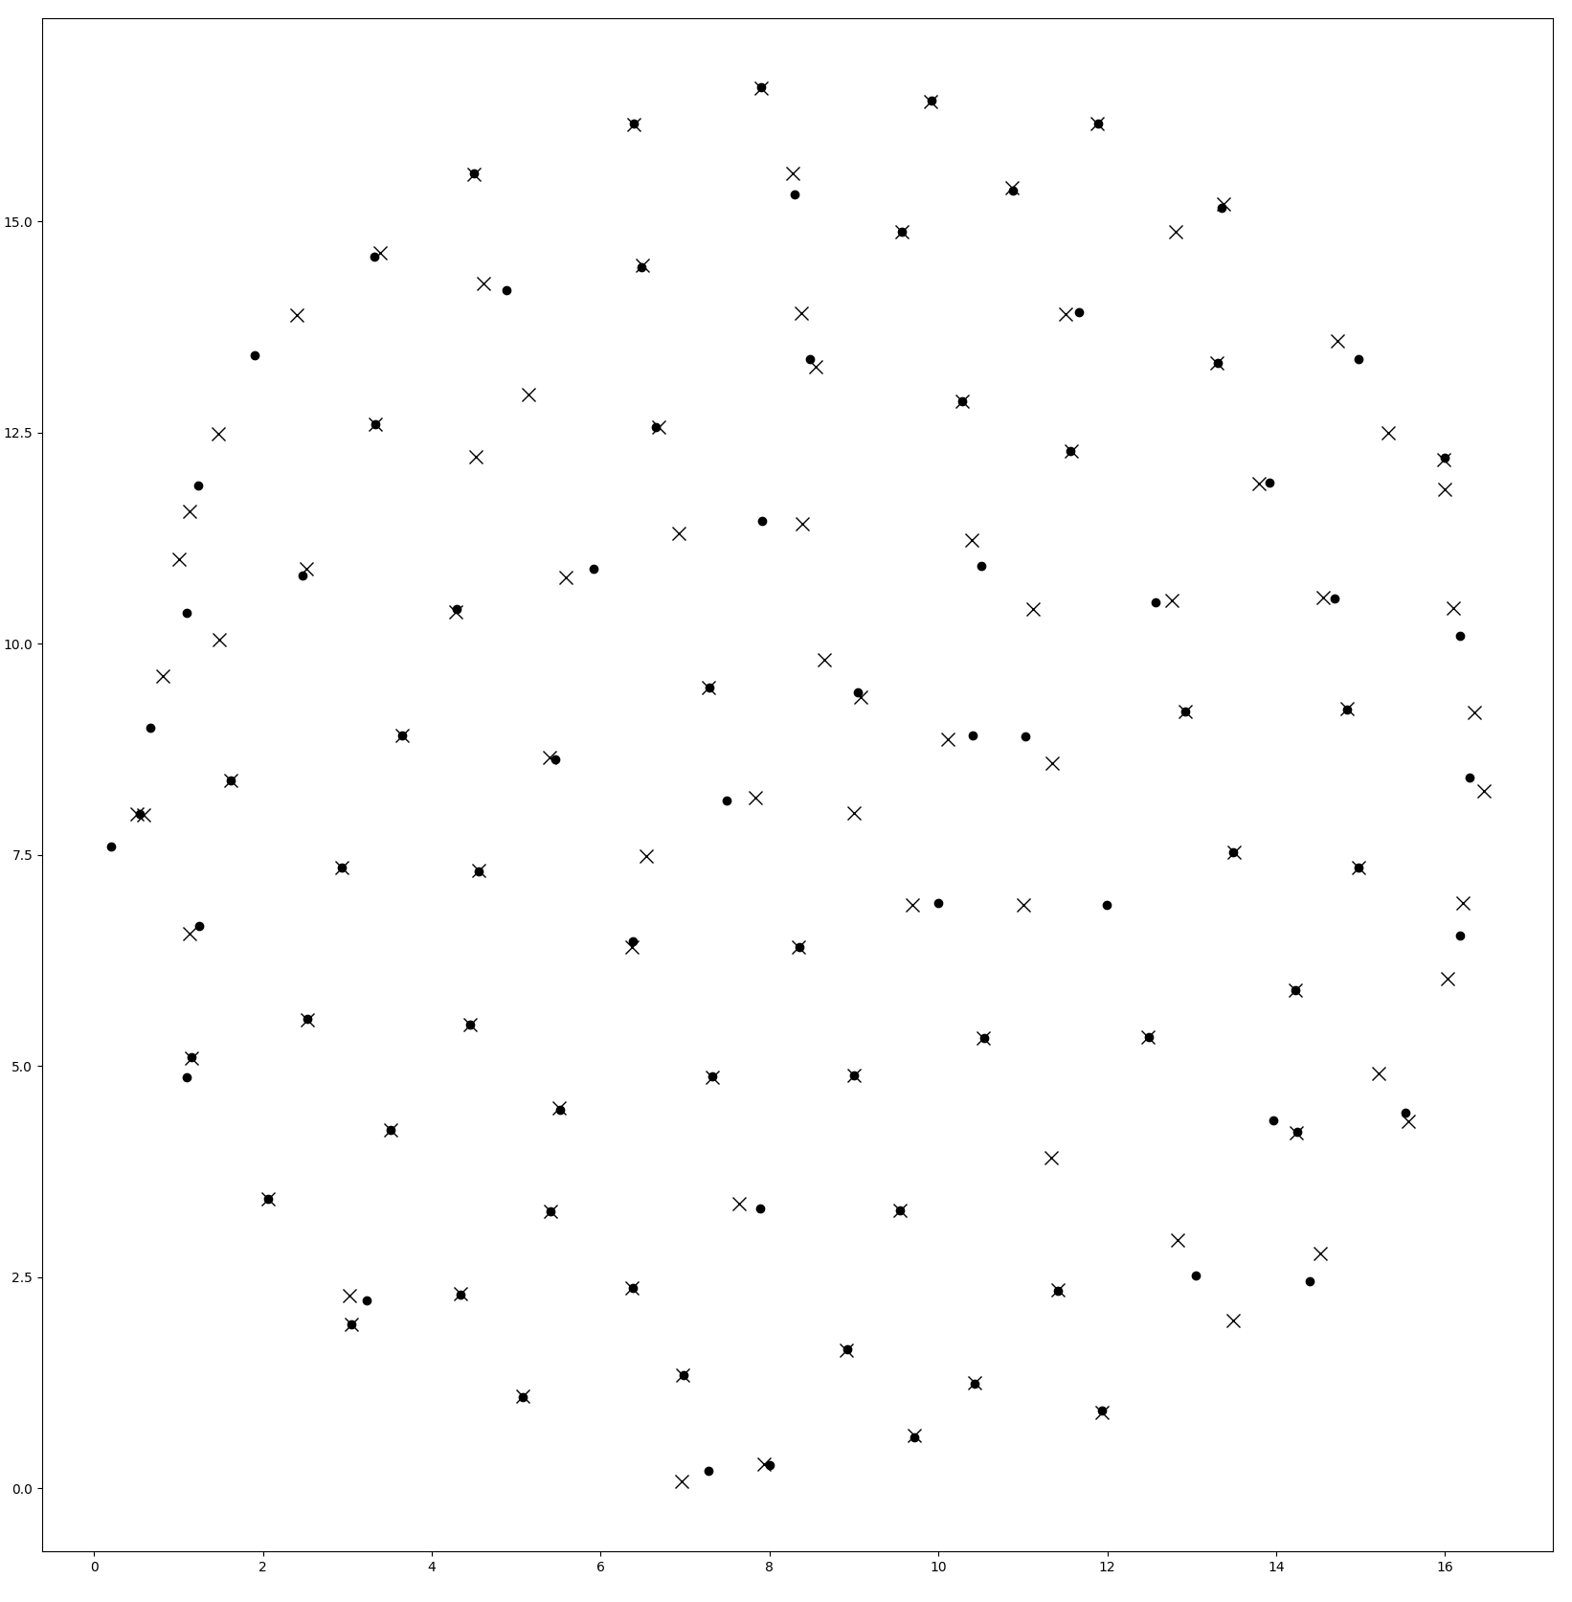
With less output noise

